Slide 1


Image Classification Using Fish
Evan Edmunds

Slide 2
Background
Images convey a lot of information, after all “a picture is worth a thousand words”
Human have an innate talent for understanding images, being able to identify an image they have seen for only 13 milliseconds.
By using the right tools, computers can be “taught” how to efficiently and accurately process and identify pictures
This process of identifying pictures is called image classification and has many uses: cancer detection, facial recognition, autonomous driving, and more.

Slide 3
Purpose
Develop a neural network model using images of different types of fish
The model must be able to identify the type of fish quickly with an acceptable degree of accuracy
This model will then serve as an example of a possible use case of an image recognition in a real-world setting.
With this set of data, that could mean separating fish in a packaging/distribution line or automatically ringing up customers in a store based on the fish placed on the counter.

Slide 4
Data
This dataset contains 430 images of 9 types of fish.
Each fish type had a total of 50 images available, except for one, which had only 30
The images had resolution of 2832 x 2128 or 1024 x 768, since two different cameras were used to take them
All photos were in color

Slide 5
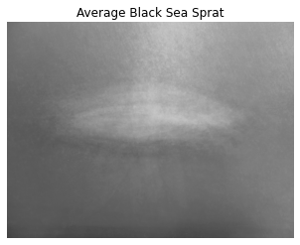
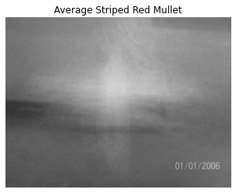
Data Exploration
Exploratory analysis was difficult due to the nature of image data. One approach that did provide some insight were mean images, shown above.
From this, it’s clear that the photos were all taken from the same angle of directly above the fish, but some of the photos different in their orientation.

Slide 6
Data Collection and Processing
All data was placed into numpy arrays and labels for the data were placed into a separate list.
Labels were converted to integers and then one hot encoded
The data was split into testing and training sets, with the testing set being 20% of the total data.
The training data was then rescaled from integer values to a scale of 0 to 1

Slide 7
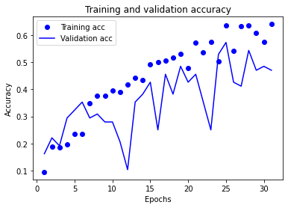
Modeling
To assist with the lack of data, image augmentation was used to generate more training data.
Learning rate decay and a L2 regularization were implemented to avoid overfitting to the training data
A keras sequential model with convolution and pooling layers was used as the structure of the neural network
As seen on the left, model training accuracy was around 60%

Slide 8
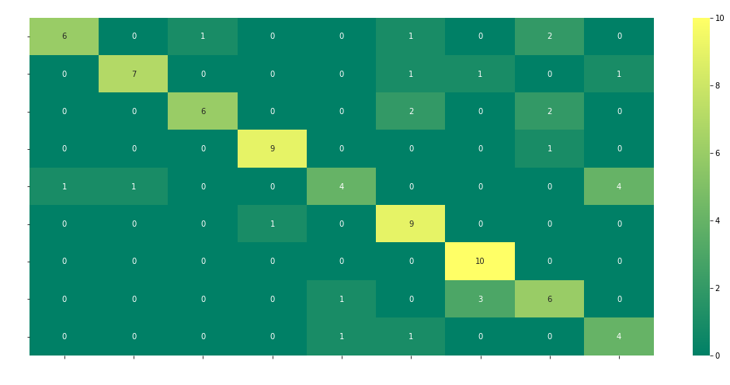
Results
Unfortunately, the results of the model are underwhelming.
The accuracy score when using the test set was 71%

Slide 9
Final Remarks
Despite the disappointing conclusion, the project shows how to approach an image classification problem
With more work and time put into the model, I am confident that this model would be useful for identifying fish in a real world setting, such as problems listed earlier of packaging separation and transactions
Overfit is the clear reason for poor model performance, demonstrated by the fluctuating validation accuracy.
One possible solution is generating more augmented data

